Slide 1


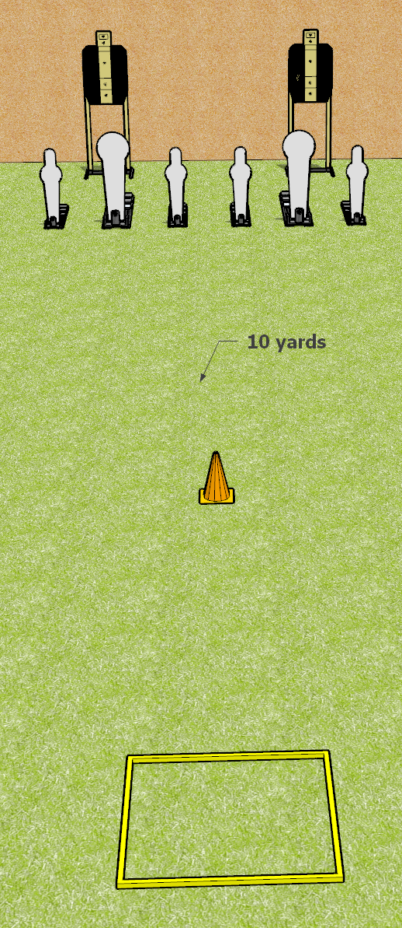
 | Dothan Gun Club – USPSA Match My One Weakness Course Designer : Drew Coleman
START POSITION : Standing in the shooting box. Wrists below belt.
GUN READY CONDITION : Pistol loaded and holstered. PCC loaded, shouldered, safety on, pointed at orange cone. |  | SCORING: Comstock, 12 rounds TARGETS: 2 paper, 6 Steel SCORED HITS: Best 3 on paper, steel until down START-STOP: Audible, last shot RULES: failure to perform a mandatory reload before changing arrays is a procedural per shot fired. Failure to engage 2nd array weak hand only is a procedural per shot fired
STAGE PROCEDURE: Engage the poppers or the paper targets, perform a mandatory reload and then engage the other array weak hand only

